Slide 1
EENG 284 Introduction
Notes:
Usually the <title of the lab> is what will be called the “System” through the rest of this document

Slide 2
Who are we?
Introduce yourself.

Slide 3


Slide 4
Lab Objectives
Working with the Quartus IDE
Verilog skills
Creating logical expressions in Verilog
Concurrent Signal Assignments
Simulation
Working with testbenches
Working with ModelSim (run command)
Creating timing diagrams
Verifying design

Slide 5
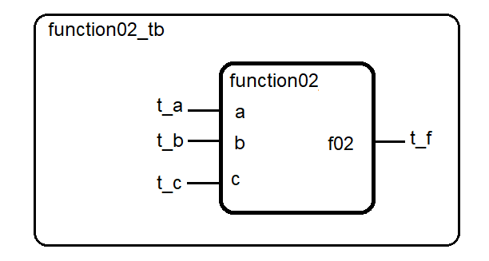
Building and testing digital circuits
2 files
Digital circuit function02.v Logic for circuit
Testbench function02_tb.v Test inputs for circuit
Notes:
Replace <System> with the name of the

Slide 6
Circuit – code for gates
Concurrent assignment statements
assign p1 = ~a & ~b & c;
assign p2 = ~a & b & ~c;
assign p4 = a & ~b & ~c;
assign p7 = a & b & c;
assign f03 = p1 | p2 | p4 | p7;
All lines of code happen at the same time concurrent
All lines of code happen all the time continuous
Notes:
Replace <System> with the name of the

Slide 7
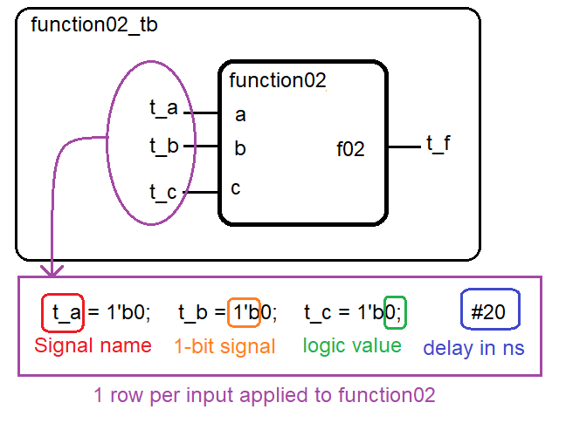
Testbench – driving inputs to circuit
Notes:
Replace <System> with the name of the

Slide 8
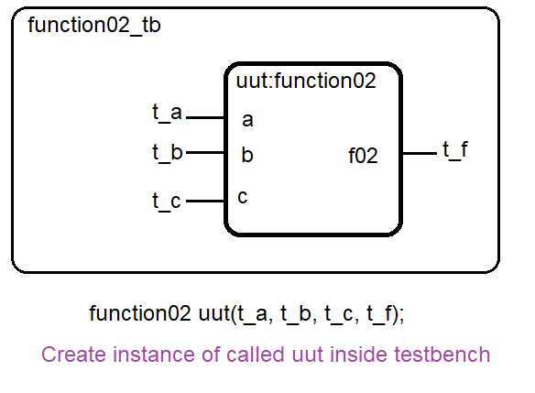
Testbench – instantiation of test circuit
Notes:
Replace <System> with the name of the

Slide 9
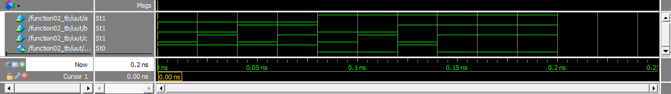
Circuit - output
Timing diagram – logic level vs. time
(a,b,c) = (1,1,0) what is f equal? Yes, f is the bottom trace.
Notes:
Replace <System> with the name of the

